Slide 1
Project: Blood Donation Finder
By Group 7
Aryan Mainalee
Deepesh Bastola
Sulav Tiwari
Under Supervision of
Sanju Shrestha

Slide 2
Table of Contents
Project Recap
System Architecture and Tech Stack
What We Have Built So Far
Testing Results
Challenges Faced
Upcoming Features
Conclusion

Slide 3
Project Recap
The Problem
No centralized blood donor platform in Nepal
Patients rely on phone calls & social media
Delays in finding compatible donors
Outdated donor records & rare blood groups hard to locate
Manual processes slow emergency response
Our Objectives
Donor registration & profile management
Online blood request posting by recipients
Automated matching by blood type & location
Real-time notifications to compatible donors
In-app chat between donor & recipient
Secure authentication & donor history tracking

Slide 4
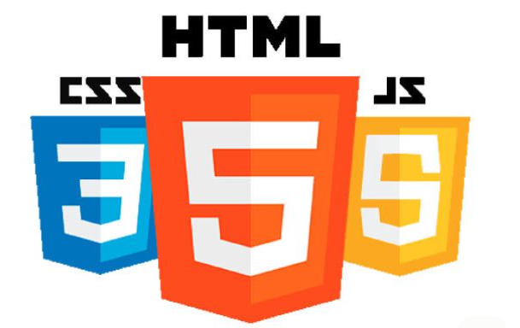
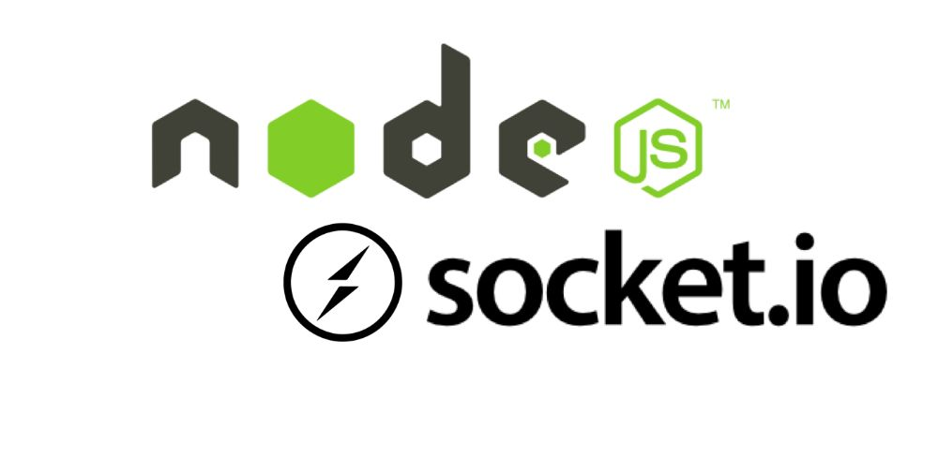
SYSTEM ARCHITECTURE & TECH STACK
Frontend: HTML, CSS, JavaScript
Responsive UI: Home, Dashboard, Blood Request Page, Donor List, Chat, Admin Panel
Backend: Node.js, Express.js, JWT
Business logic, API routing, secure authentication & session management

Slide 5
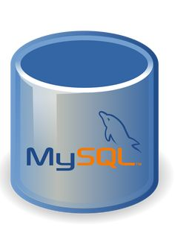

SYSTEM ARCHITECTURE & TECH STACK
Real-Time Layer: Socket.io
Bidirectional communication for in-app chat and instant donor notifications
Database Layer: MySQL
Users, Donors, Blood Requests, Notifications, Chat, Donation History tables

Slide 6
What We Have Built So Far
Responsive UI Design: Home Page, Login, Signup, Browse Blood Drives, Organization page; all responsive across mobile, tablet, desktop
Authentication Module: User login/signup connected to MySQL. Credentials validated server-side. Error messages for invalid inputs.
Database Connectivity: Backend Node.js + Express.js successfully connected to MySQL. User data stored and retrieved during login flow.
Frontend Navigation & Layout: Page routing and navigation between Home, Login, Dashboard implemented. Clean and minimal UI layout.

Slide 7
Testing Results
Unit Testing
System Testing
Test Case | Module | Result
TC01 - Desktop layout | UI Design | ✓ PASS
TC02 - Mobile responsiveness | UI Design | ✓ PASS
TC03 - Valid login credentials | Login System | ✓ PASS
TC04 - Invalid credentials | Login System | ✓ PASS
TC05 - MySQL data verification | Database | ✓ PASS
Test Case | Scenario | Result
ST01 | UI Responsiveness (multi-device) | ✓ PASS
ST02 | Login with valid credentials | ✓ PASS
ST03 | Login failure handling | ✓ PASS
ST04 | DB connectivity check | ✓ PASS
ST05 | Page navigation flow | ✓ PASS

Slide 8
PROBLEMS/CHALLENGES
Designing the database schema with correct foreign key relationships required careful upfront planning to avoid restructuring later.
Configuring Node.js + Express.js to communicate stably with MySQL required significant debugging of connection and async query handling.
SMS notification integration was dropped due to third-party API costs and technical complexity beyond the project's budget.
Donor availability accuracy depends entirely on users updating their own status, which cannot be enforced technically.

Slide 9
WHAT'S REMAINING: Upcoming Features
Donor & Organization Modules: Full profile management for donors, organizers as well as admin for making clean and transparent dashboard within themselves.
Blood Request & Donor Matching: Recipients post requests; system auto-matches donors by blood group and geographic proximity.
Real-Time Notifications: Socket.io-powered instant alerts to matched donors when a new emergency request is posted.
In-App Chat System: Bidirectional messaging between confirmed donor-drive pairs via Socket.io chat.

Slide 10
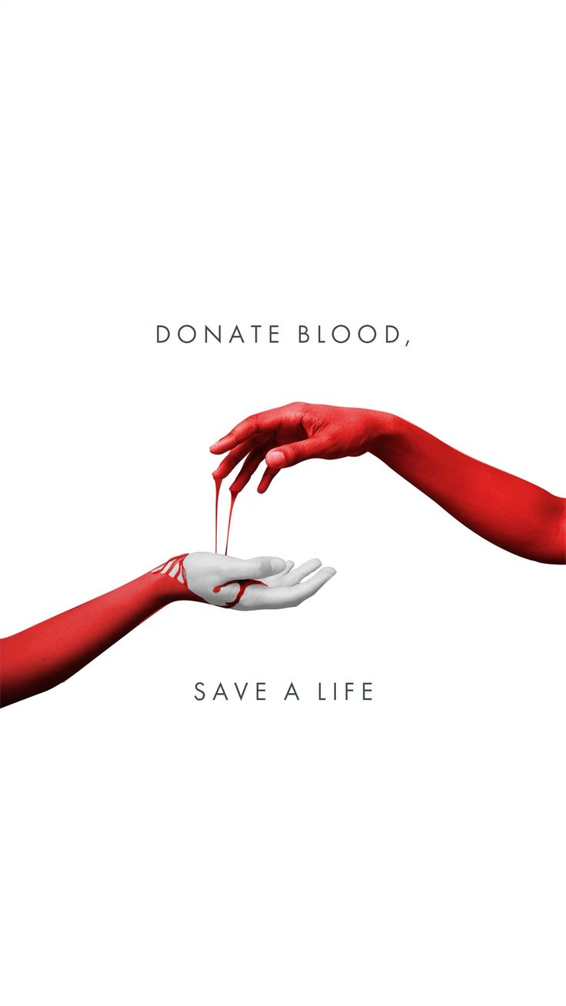
CONCLUSION
So, the (Blood Donation Finder) project is aimed to be developed as a fast, reliable and fully functional within scheduled timeline i.e. end of 13th week.

Slide 11


